Slide 1

AI Dress Code
Compliance System
AI Powered Real Time Dress Code Detection via CCTV

Slide 2
PROBLEM STATEMENT
The Problem
Why It Matters
Manual Dress Code checking at Gates.
Slow, Inconsistent and Error Prone.
No Record of Violation.
HR has zero data about compliance trends.
Negligence in Policy Implementation by Staff at gate.
Inconsistent implementation damages work culture and discipline.
No data means no accountability.
Management cannot make informed decisions about policy.
Scaling Manual checking on multiple entrances is expensive.

Slide 3
SOLUTION OVERVIEW
Key Features
Value Proposition
• Real Time Dress Code Check via CCTV feed
• YOLOv8 Model for Detection
• Green Box for Compliant, Red for Noncompliant
• Automatic Snapshot saving on Violation
• Daily Report Generation to HR
• Automated System, no hiring for checking
• AI ensures unbiased monitoring, no partiality
• Cost Effective
• Complete privacy, data stays local
• Can be Scaled on multiple cameras in future
Python
YOLOv8
OpenCV
PyTorch
Pandas

Slide 4
REQUIREMENTS SUMMARY
Functional Requirements
Non-Functional Requirements
Real Time Dress Code Detection
Performance:
15+FPs, detection under 2 sec
Security:
Password Protected, local, no internet
CCTV camera live stream processes. Shirt, tie, Id detected through YOLOv8 model. Compliant dress code appears in green box, non-compliant in red box.
Reliability:
85% accuracy at 300-500 lux lighting
Usability:
Staff Trained in 15 minutes
Violation Logging and Snapshot Capture
On Violation, system automatically snapshots with Date, Time and Missing item. Captured Image is then stored in local storage
Portability:
Windows 10/11+ Ubuntu 20.04+
Availability:
8hrs continuous, auto restart on error
Daily Compliance Report
HR Manager generates a daily report of total Detected, Violated and compliant counts.

Slide 5
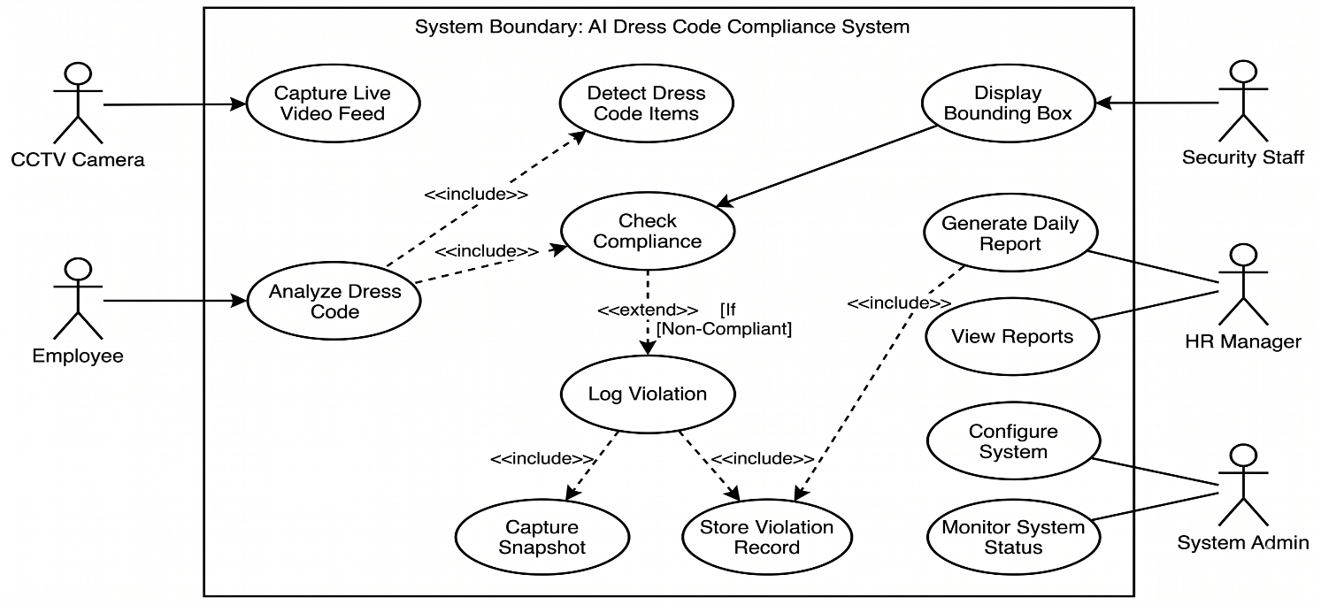
SRS HIGHLIGHTS
[UC-1]
Real Time dress code detection
Employee enters camera range. System captures frame, YOLOv8 detects clothing items, checks against dress code policy. Compliant = green box, non-compliant = red box and triggers violation logging.
[UC-2]
Violation Logging & Snapshot
Triggered by UC-1 when violation detected. System captures frame, adds date/time/missing items metadata, saves snapshot to local storage. If storage full, alerts admin.

Slide 6
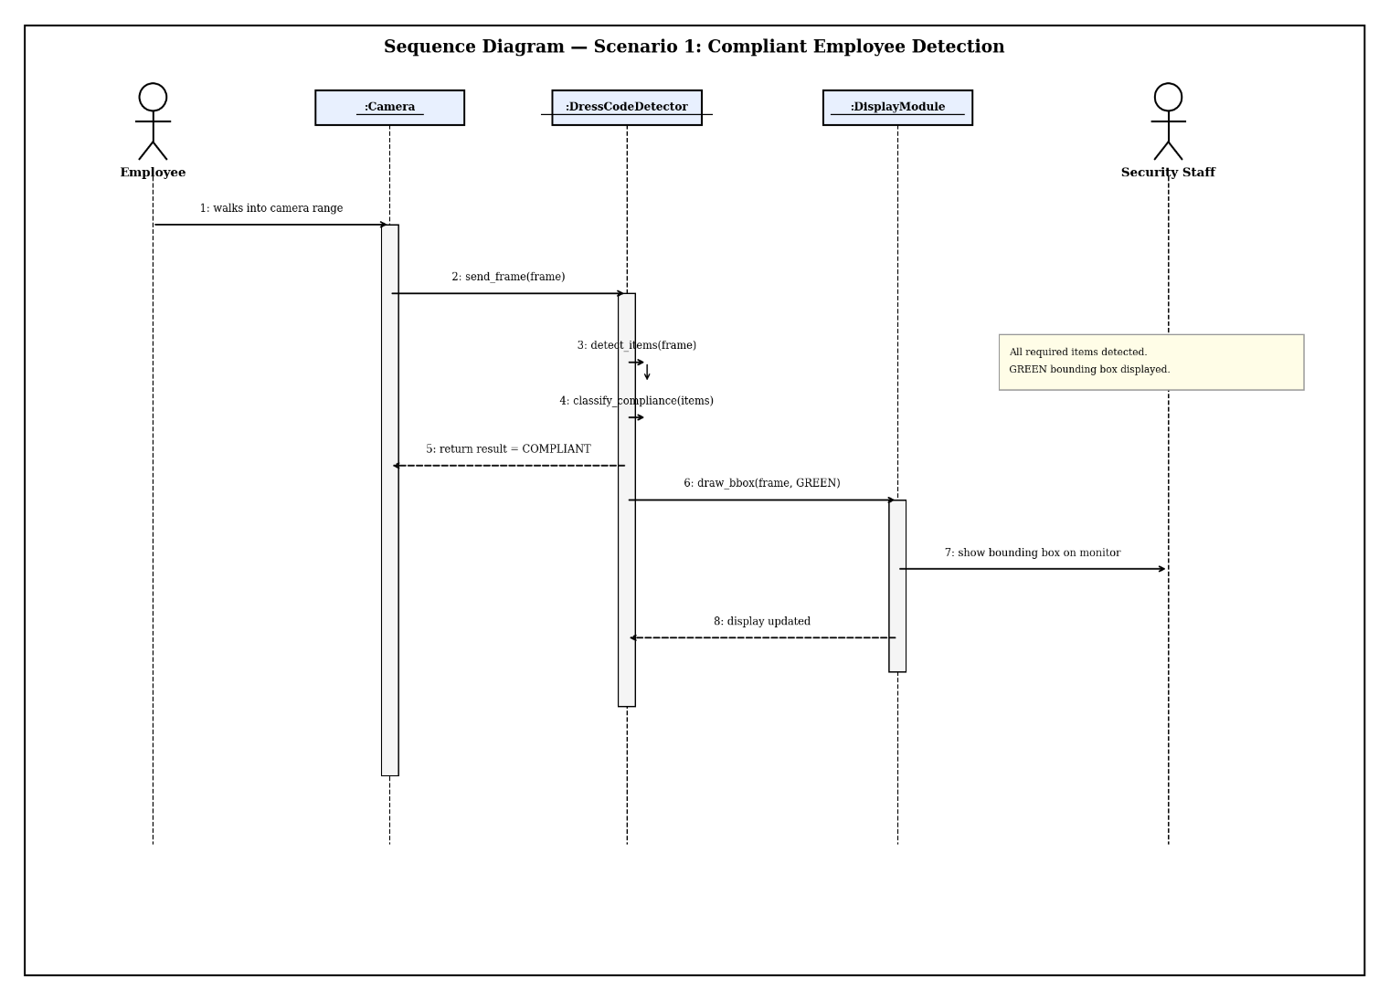
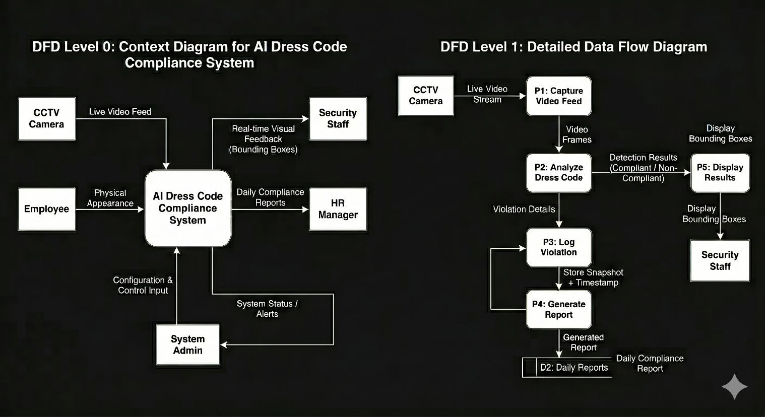
DESIGN MODELS
Sequence Diagram
Context Level Diagram

Slide 7
TECHNOLOGY STACK
Python 3.8+
YOLOv8
(Ultralytics)
OpenCV
PyTorch
Pandas
▶
▶
▶
▶
Language
AI Model
Vision Lib
Framework
Data Tool
HARDWARE & ENVIRONMENT
NVIDIA GPU 4GB VRAM
720p HD CCTV Camera
Windows/Ubuntu
8GB RAM, 50GB Storage

Slide 8

WHAT MAKES US DIFFERENT
Unique Innovation
Unlike existing PPE and face mask detection systems, our solution specifically targets office dress code compliance — a gap in current AI monitoring solutions. No face recognition needed, fully privacy-safe, works with any standard CCTV.
No Face Recognition Needed
Fully Offline Operation
Configurable Dress Code Rules
System checks clothing only — no biometric data stored, complete employee privacy
No cloud, no internet — all processing on local machine, data never leaves premises
Company changes policy? Just update the required items list — no code change needed (Strategy Pattern)

Slide 9
IMPACT & FEASIBILITY
PKR 320K
1.25 Years
82.6%
Annual Net Savings (380K benefits - 60K operating)
Payback Period
First Year Investment Recovery
Impact
Feasibility
Replaces 1 security guard — saves PKR 240K/year salary
HR saves 60K/year in manual monitoring time
Automated reports save admin hours — 30K/year
Improved employee discipline — fewer violations over time
Total development cost only PKR 400K (one-time)
Uses proven open-source tech — Python, YOLOv8, OpenCV
Already tested with live CCTV feed
COCOMO estimate: 5.1 months, 1-2 Developers

Slide 10
FUTURE SCOPE
Multi-Camera Support
Database Integration
Move from local file storage to MySQL/SQLite for better data management and querying
Current version supports single camera — future version can handle multiple entrances simultaneously
Email/SMS Alerts
PPE Detection for Factories
Auto-notify HR or admin when violation detected — real-time alerts on phone
Same model can be retrained for helmet, safety vest, gloves detection in industrial settings

Slide 11

WHY INVEST IN US?
Solves a Real Problem:
Every organization with dress code needs this — huge market
Low Cost, High Return:
PKR 400K investment, pays back in 1.25 years, saves 320K annually
Scalable and Adaptable:
Multiple cameras, multiple locations, retrainable for any industry

